Slide 1

INTRODUCING……
Customized Employment
Notes:
CINDY

Slide 2

How are we defining employment?
Competitive integrated employment as defined by WIOA is:
Work that is performed full time or part time at least minimum wage and not less that the customary rate paid for similar work
Eligibility for level of benefits provided to others in similar positions
Location where there is interaction with other people without disabilities as would be found in comparable positions
Provides, as appropriate, opportunities for advancement.
Includes supported and customized employment
Notes:
Steve So basically, competitive integrated employment is defined by compensation and integration. The type or amount of support does not determine whether a position is consider to be Competitive Integrated Employment

Slide 3
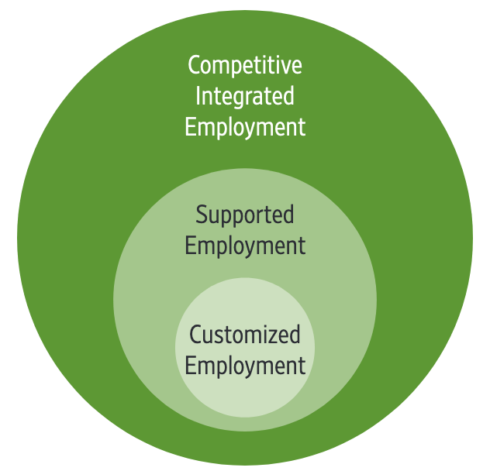
So what do we mean by supported and competitive employment?
Supported employment is competitive integrated employment for those with more significant disabilities who need to ongoing support services
Customized employment is supported employment that is acquired and maintained through the use of strategies that individualize the employment relationship between employees and employers that meet the needs of both.
Notes:
Cindy Supported employment is not group employment – group employment is just that, group employment.
So why do we want to make this distinction? Sometimes we hear things like a person has to be indepent in order to be competitively employed and that just is not the case…

Slide 4
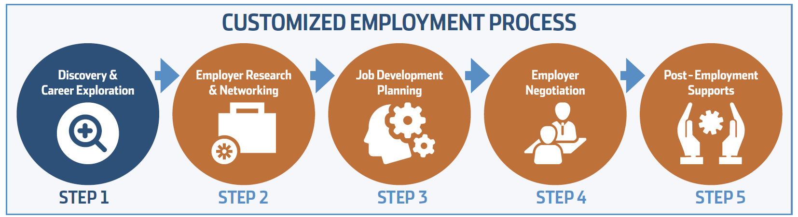
What is customized employment?
ThinkCollege Transition Project Grab and Go Practices, Issue No. 6. www.thinkcollege.net/tct
Notes:
Cindy

Slide 5

Discovery: Getting to know the Job seeker
An experiential process
Observing
Participating
Learning
Develop a profile that identifies
Interests and key themes
Conditions for success
Contributions
Challenges
Notes:
CINDY

Slide 6
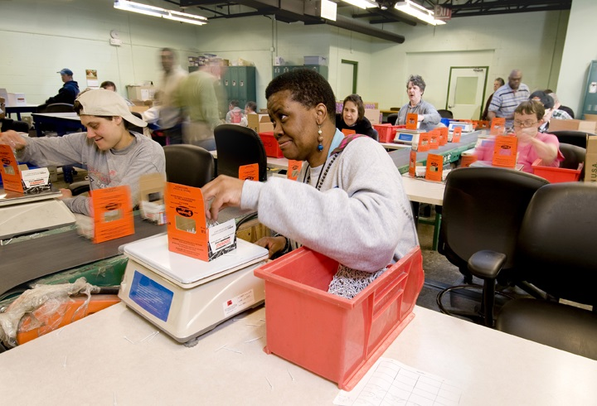
Nancy From workshop to workforce
Notes:
Steve -Since transitioning out of high school, Nancy attended WORK, Inc. 5 days a week to participate in sheltered workshop jobs
-Nancy loved having a paycheck and doing piecework, it gave her enormous pride and defined her idea of work and what daily adult life was as she knew it
-When the workshops closed, Nancy appeared totally lost. Her family was angry that they could not keep her in a workshop and not confident that she would find competitive employment or be safe in the community.
-During the transformation to Community Based Day Services at Work Inc, Nancy was always the first one to ask to go out of the building on trips and would avidly participate in volunteer site work, but she still wanted
-During a time when Nancy and her family felt they had very little certainty about her Nancy was one of the first participants randomly selected to participate in Work Inc’s new customized employment program Pathways to Careers

Slide 7
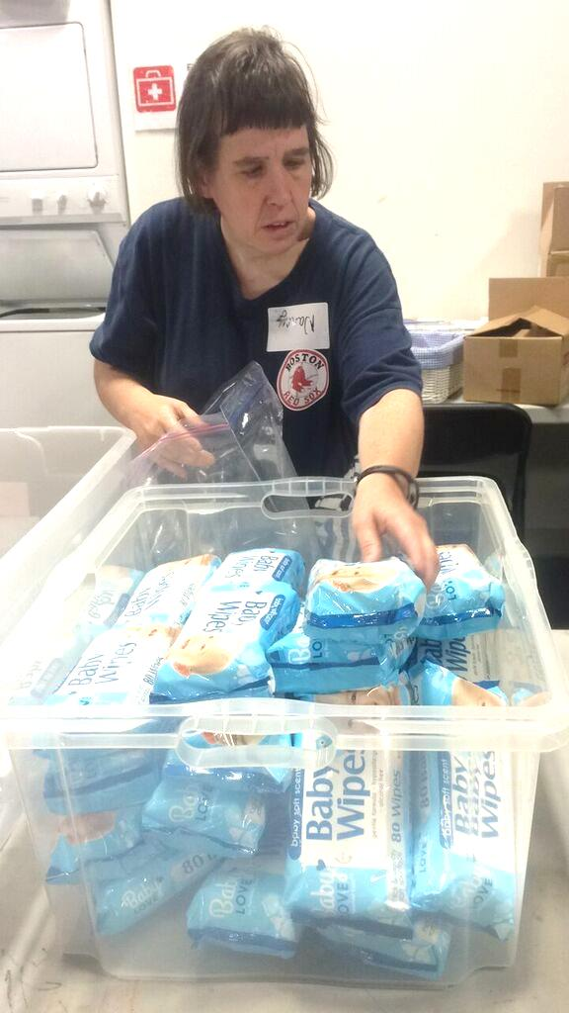
Discovery = especially helpful for job seekers with few/no previous community work experience
Notes:
Steve - In that Nancy had been in the workshop environment for so long, Discovery was uniquely useful for…. -revealing her ideal conditions for employment, especially when not restricted to the highly controlled workshop environment -learning how the workshop environment experience shaped her work habits, preferences and skillset - learning about all the things she did in her daily life already that could be translated into terms of work, or rather, which skills might also take be needed in a workplace
-exposing her to new possibilities and empowering her to consider new options through unfamiliar discovery activity
In this particular image, Nancy is completing a task at a volunteer site organized by the community based day program. A subtle skill we began to see across different routines in Nancy's life was her ability to arrange things in a spatially efficient manner as we can see here, and as we also noticed at her residence in the care she took to fold and store her own garments

Slide 8
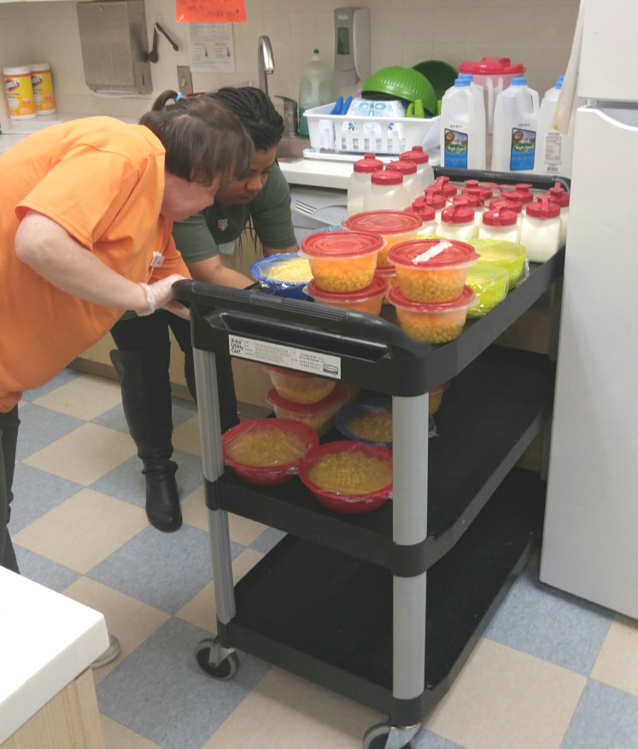
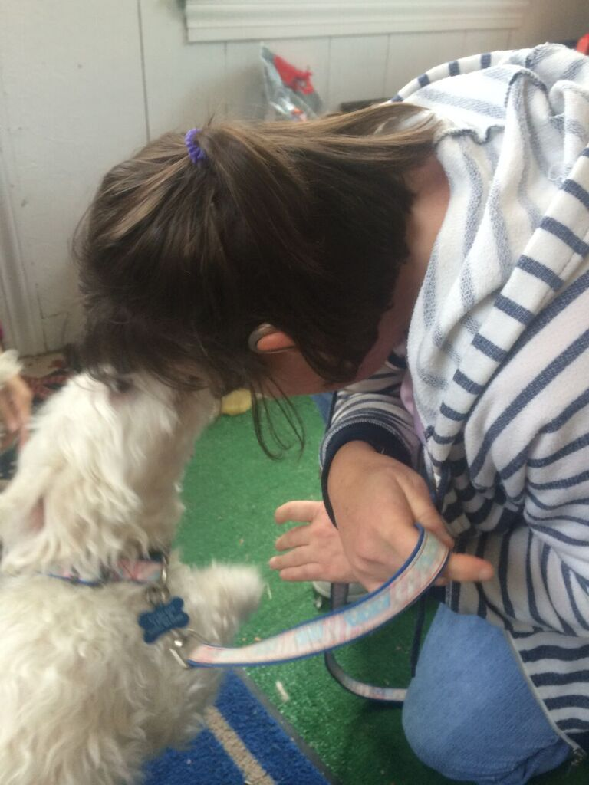
Expanded Discovery (Internship) affirms and expands on what we learn in initial discovery, further revealing ideal conditions for successful employment
Notes:
Steve Through her internship experience at a local pre-school, we learned an immense amount about Nancy’s support needs, strongest skills, environmental preferences, community access experience, and more all while simulating an actual work experience to further corroborate what we could expect from a future job, and what would need to be refined in a future job.
For the sake of time though, we will discuss that the biggest take away from her work experience was that Nancy’s success was largely impacted by being visible and social in the workplace.
Our next step was to takle this understanding in relation to one of her primary interest areas – working with dogs.
We opted to seek a second internship experience at a local Groomer.

Slide 9
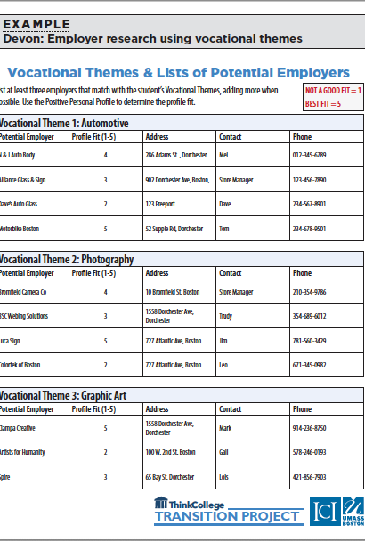
Employer Research and Networking
Using the job seeker profile developed through discovery to identify target businesses
Local environmental scan
Use of personal and professional networks
May involve contacting different types of businesses based on the job seekers profile
Engage with businesses to learn more about needs, requirements, opportunities that may align with the job seekers profile.
May include job tours and information interviews
Evaluate potential “fit” for job seeker
Notes:
Cindy

Slide 10
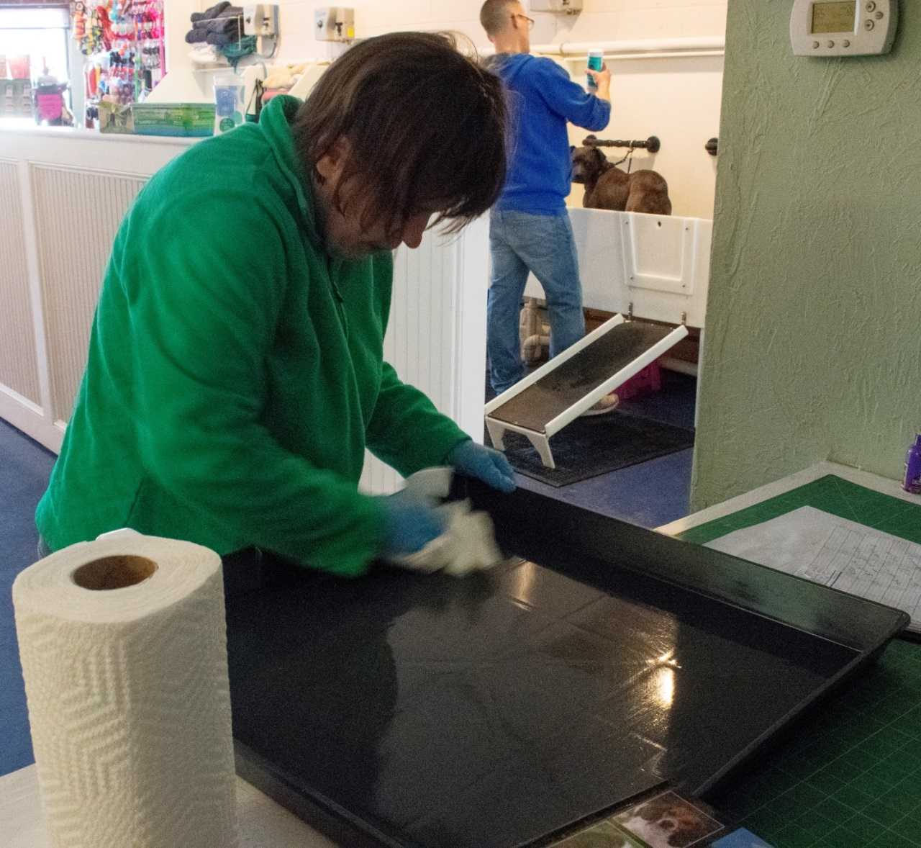
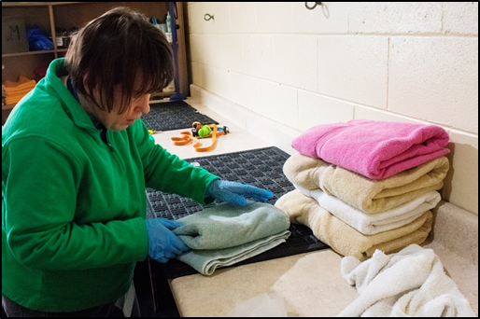
Customized internships often lead to customized employment
Notes:
Steve At Modern Dog, the employer partnered with us to carve a list of tasks that were considered by them to be unmet needs, or tasks that needed to be completed regularly but were not always completed on time when groomers were busy on higher level duties
Nancy proved invaluable in the shop during her internship while completing these designated tasks , and by the end of her 10 week internship she was offered the opportunity to stay on as a regular employee

Slide 11

Job Development Planning and Negotiation
Brings together what you learned in discovery and employment research and networking to develop a plan for identifying employment opportunities.
Start with the job seekers ideal job – conditions and contributions
Next consider the employer needs identified during research
Develop a potential task list, matching tasks needed by employer with job seekers profile
Develop and present a job proposal
Notes:
Cindy

Slide 12

Post Employment Supports
Planning for post employment supports starts during negotiation
Good work place assessment provides a foundation
Tasks
Routines
Culture
Plan for work place support aligns with needs of job seeker and business
May include:
Systematic instruction
Behavioral intervention
Accommodations
May be ongoing, intermittent or eliminated completely over time
Plans need to be fluid and flexible to meet the needs of the business and the job seeker
Notes:
CINDY

Slide 13
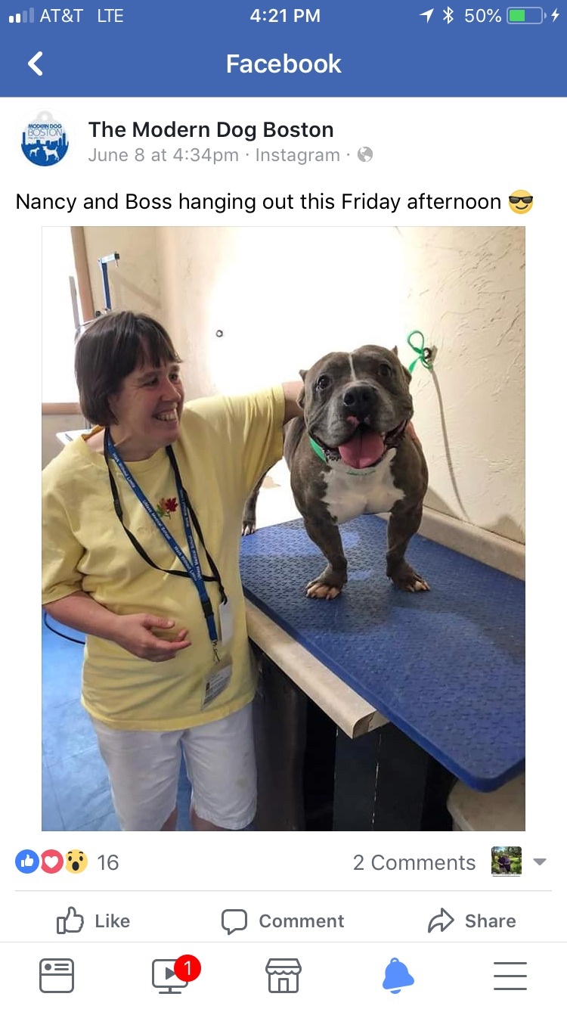
Nancy has been employed at Modern Dog for over 2 years and counting. Experiences like this show us that no matter who you are, if you want to work, there is a place for you in the workforce.
Notes:
Steve Nancy continues to be truly fulfilled at her job – it is the primary thing she talks about to others. And Modern Dog was integrated her into their team, acknowledging how she contributes to their workplace in big ways

Slide 14
Resources you can use
Think College Grab and Go Series https://thinkcollege.net/general-site-search?search_api_views_fulltext=grab+and+go
3 National Consultancies
Marc Gold & Associates www.marcgold.com
Griffen-Hammis Associates http://www.griffinhammis.com
TransCen, Inc. www.transcen.org
Notes:
Cindy/Steve

Slide 15
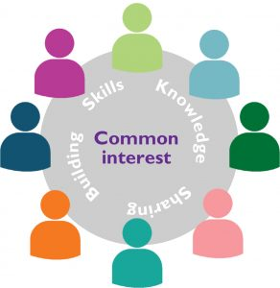
Community of Practice to Launch in FY20
To support the use of customized employment in MA
What is a CoP?
A group of people with a concern or passion for something they want to learn how to do better
Requires consistent engagement and commitment
Watch for announcement with further detail in employmentfirstma.org e-news
Notes:
Cindy/Steve

Slide 16


Contact us at:
Steve Aalto
Work Inc.
Saalto@workinc.org
617-691-1702
Cindy Thomas
Institute for Community Inclusion
University of Massachusetts Boston
Cindy.thomas@Umb.edu
617-287-4312

